Slide 1

Library System Design
Group 6
SON THACH
DUY NGUYEN
EDUARD KOSHKELYAN

Slide 2
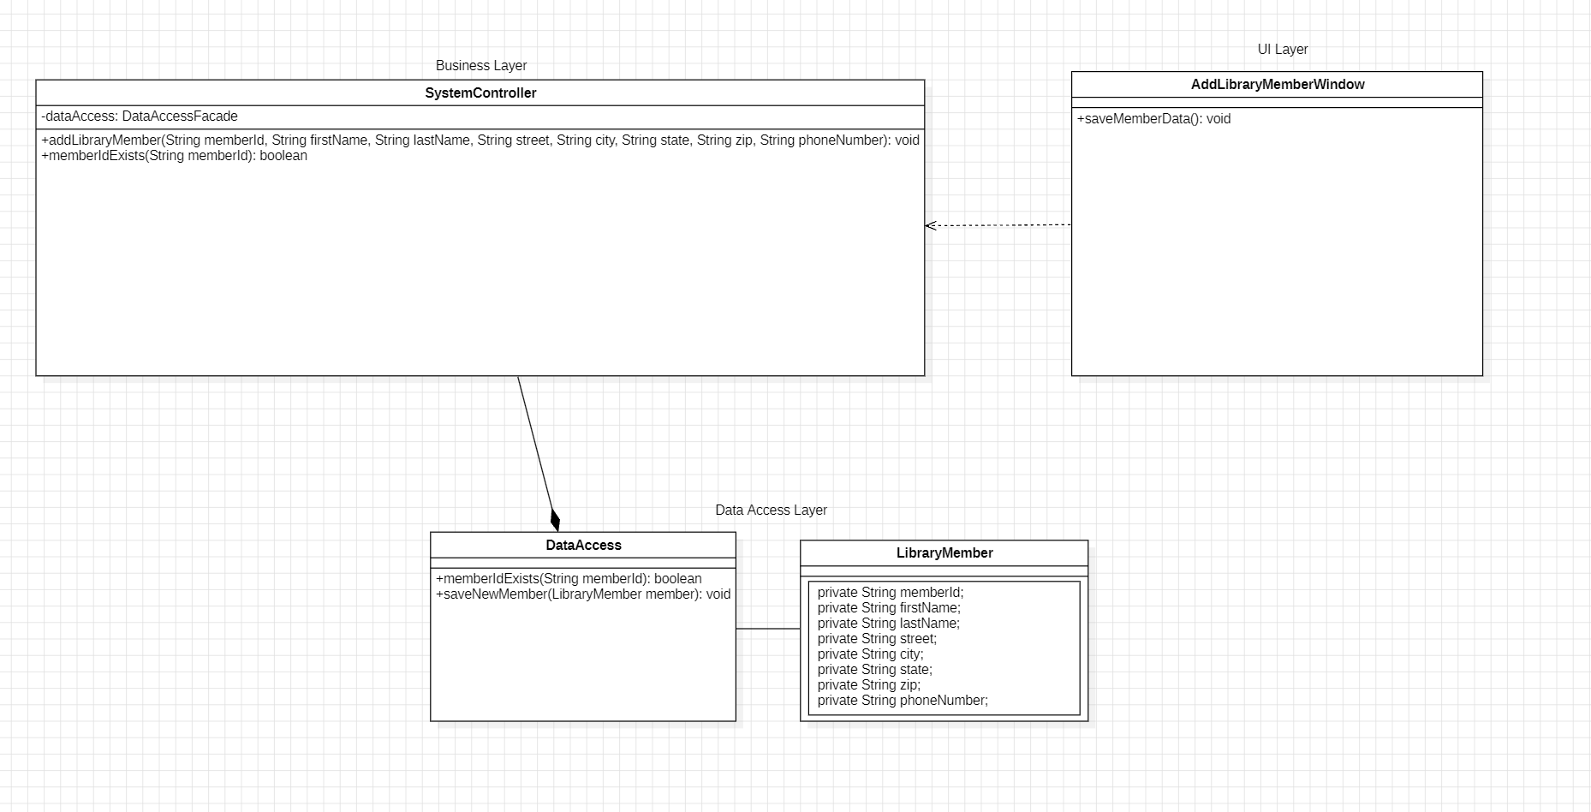
Class Diagram

Slide 3
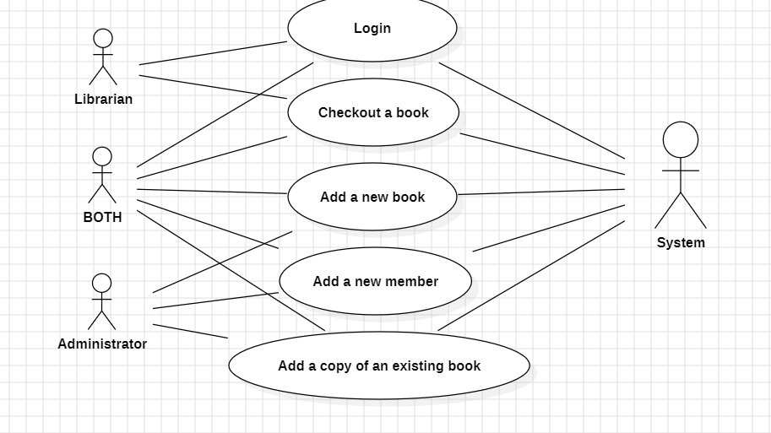
Use case

Slide 4
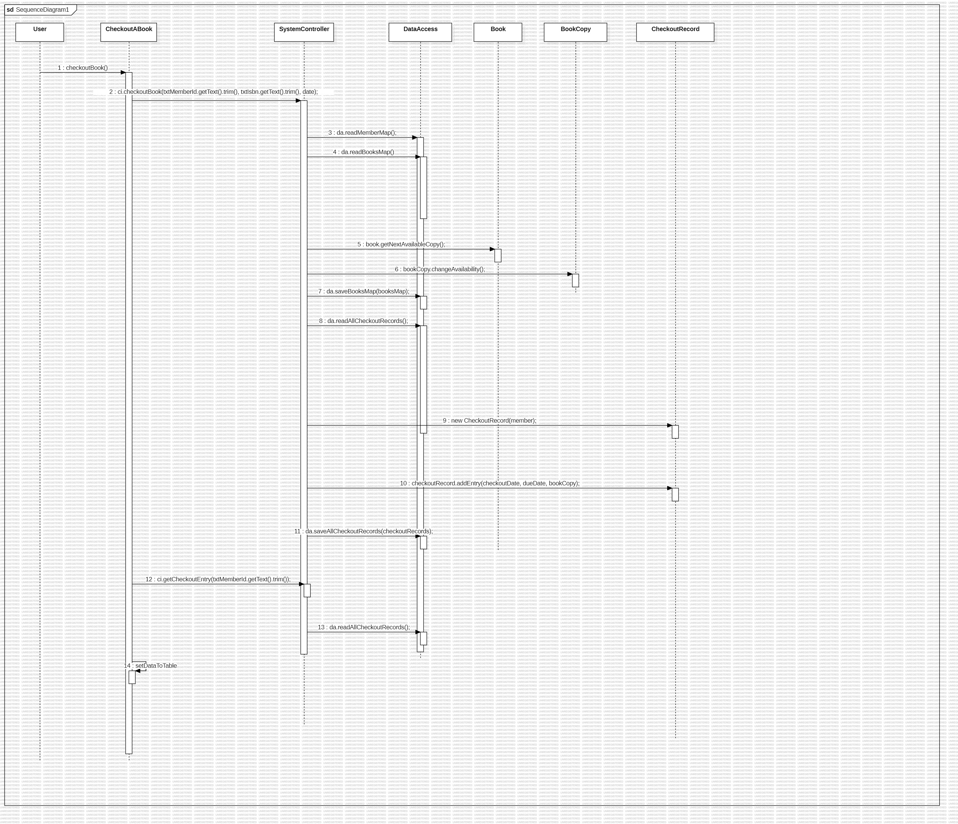
Sequence diagram - Checkout Book Use case

Slide 5
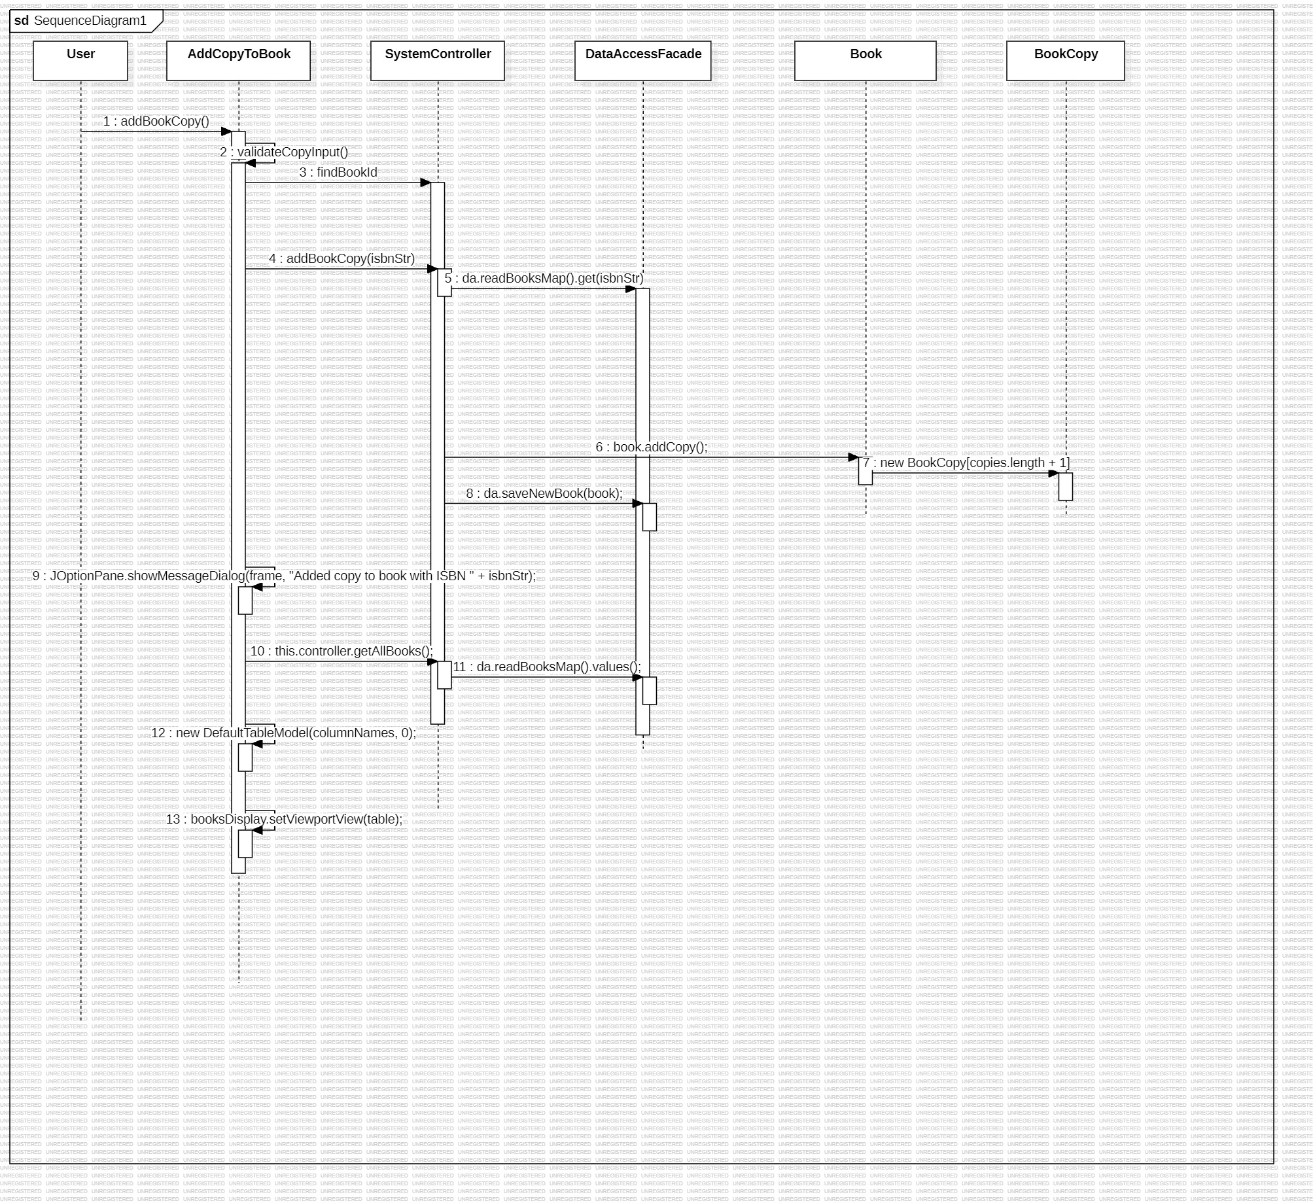
Sequence diagram - Add a copy of an existing book.

Slide 6
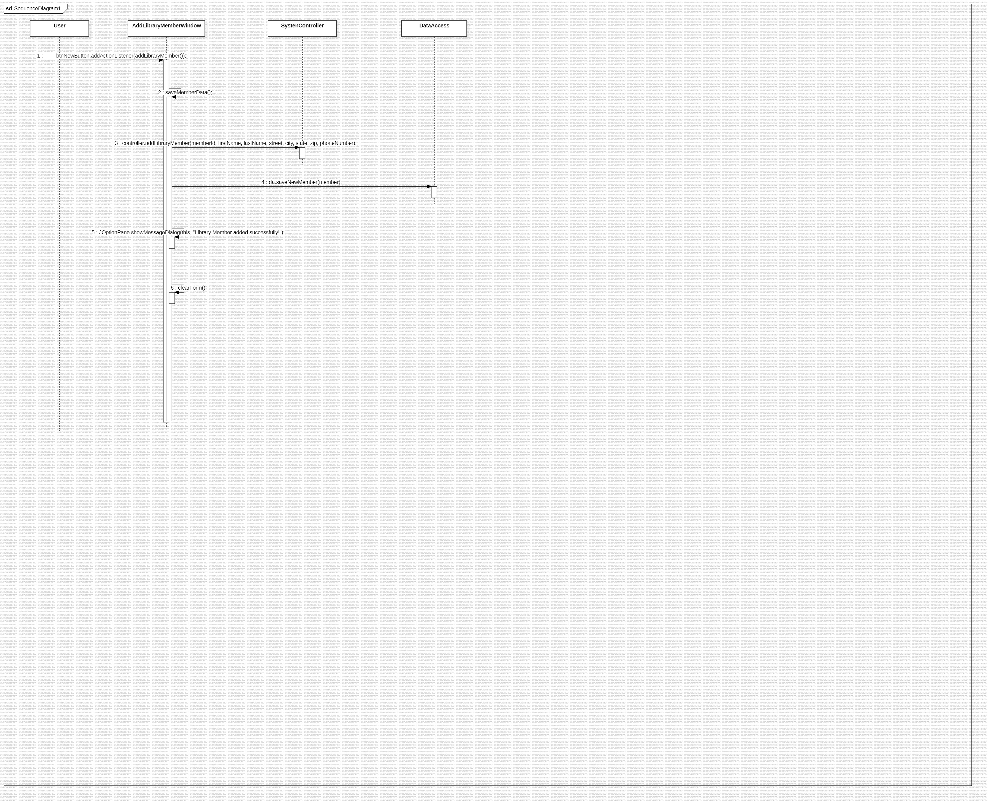
Sequence diagram - Add a new member

Slide 7
Validation rules of UI Windows.
Login Screen
Validate username and password
Add New Member
Check required fields (First name, Last name, Street, City, State, Zip Code, Phone Number).
Validate phone number.
Validate Zip Code.

Slide 8
Validation rules of UI Windows.
Add Book
Check required fields (ISBN, Authors)
Add Author
Check required fields (First name, Last name).
Validate phone number.
Validate Zip Code.
Check that the ISBN number does not exist.
Max out length must be 7 or 21

Slide 9
Validation rules of UI Windows.
Add a Copy Book
Check required fields (ISBN)
Checkout Book
Check required fields (Member ID, ISBN).
Check that the ISBN number must exist.
Check that the ISBN number must exist.
Check that the Member ID must exist.
Check availability of book.

Slide 10

Conclusion with SCI Knowledge
Problem-solving and alignment with natural law: In the same way that Transcendental Meditation (TM) allows the mind to settle into a state of deep inner peace and harmony, the process of system design in our library project reflects an alignment with natural law. By ensuring thorough validation rules and a structured flow of operations, we are creating a system that works in harmony, reducing errors and promoting efficiency. This mirrors the alignment of human actions with natural law that results from regular meditation.
Flow of interactions and awareness: The seamless flow of communication between the UI, business logic, and data access layers in our system can be compared to the flow of awareness in higher states of consciousness. Just as TM practitioners experience a clear, unbroken awareness throughout daily life, our system ensures a smooth interaction from user inputs to data processing. This clarity and efficiency enhance user experience and system reliability, much like the state of enlightenment promotes effortless thinking and action.

